Slide 1

Technical Assessment
PT. XYZ Loan Apps
Muhamad Farhan Rifai as Candidate Solution Analyst
07 December 2023

Slide 2
High-level Architecture Loan Apps
Presentation Layer
Mobile Apps Interface
Back-office Application
Login Screen
User Registration Screen
Loan Information Screen
Dashboard Screen
Loan Request Screen
Splash Screen
Sidebar Screen
Personal Information Screen
Settings Screen
Notification Screen
Application Layer
Mobile Apps Internal Services
Back-office Application Services
Loan Processing Services
Notification Services
Payment History Services
Loan Verification Services
Disbursement Services
Billing Services
XYZ Loan Apps
API Gateway
Customer Management Services
Authentication & Authorization Services
User Management Services
Document Management Services
Data Layer
External Services Layer
Mobile Apps Databases
Mobile Apps Topic
EDM & Analytics
SMS / WA Notification Service
Loan
Customer
Payment
Administration
token
Email Notification Services

Slide 3
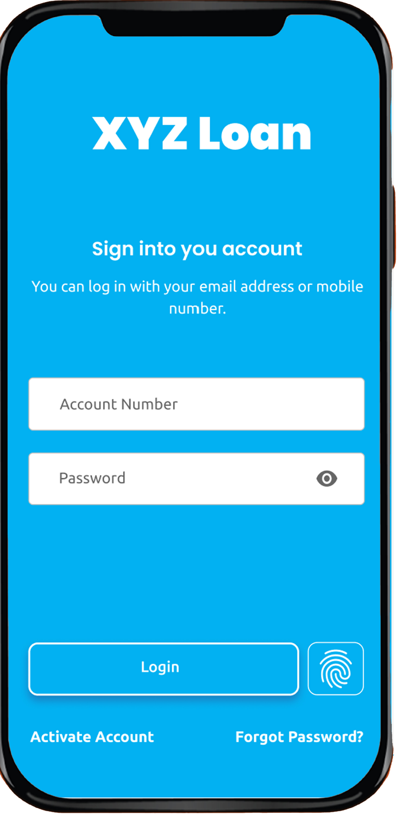


Microservices API Architecture
HTTPS : Rest API
SMTP
API Gateway
Subscribe
Email Notification
XYZ Loan Apps
Microservices API
Rest API
Rest API
Rest API
Message Broker
Rest API
Rest API
Rest API
token
CustomerManagement Services
Loan Services
Payment Service
Auth Services
Notification Services
WhatApps Notification
Publish
Customer
Loan
Payment
Administration
Notification

Slide 4
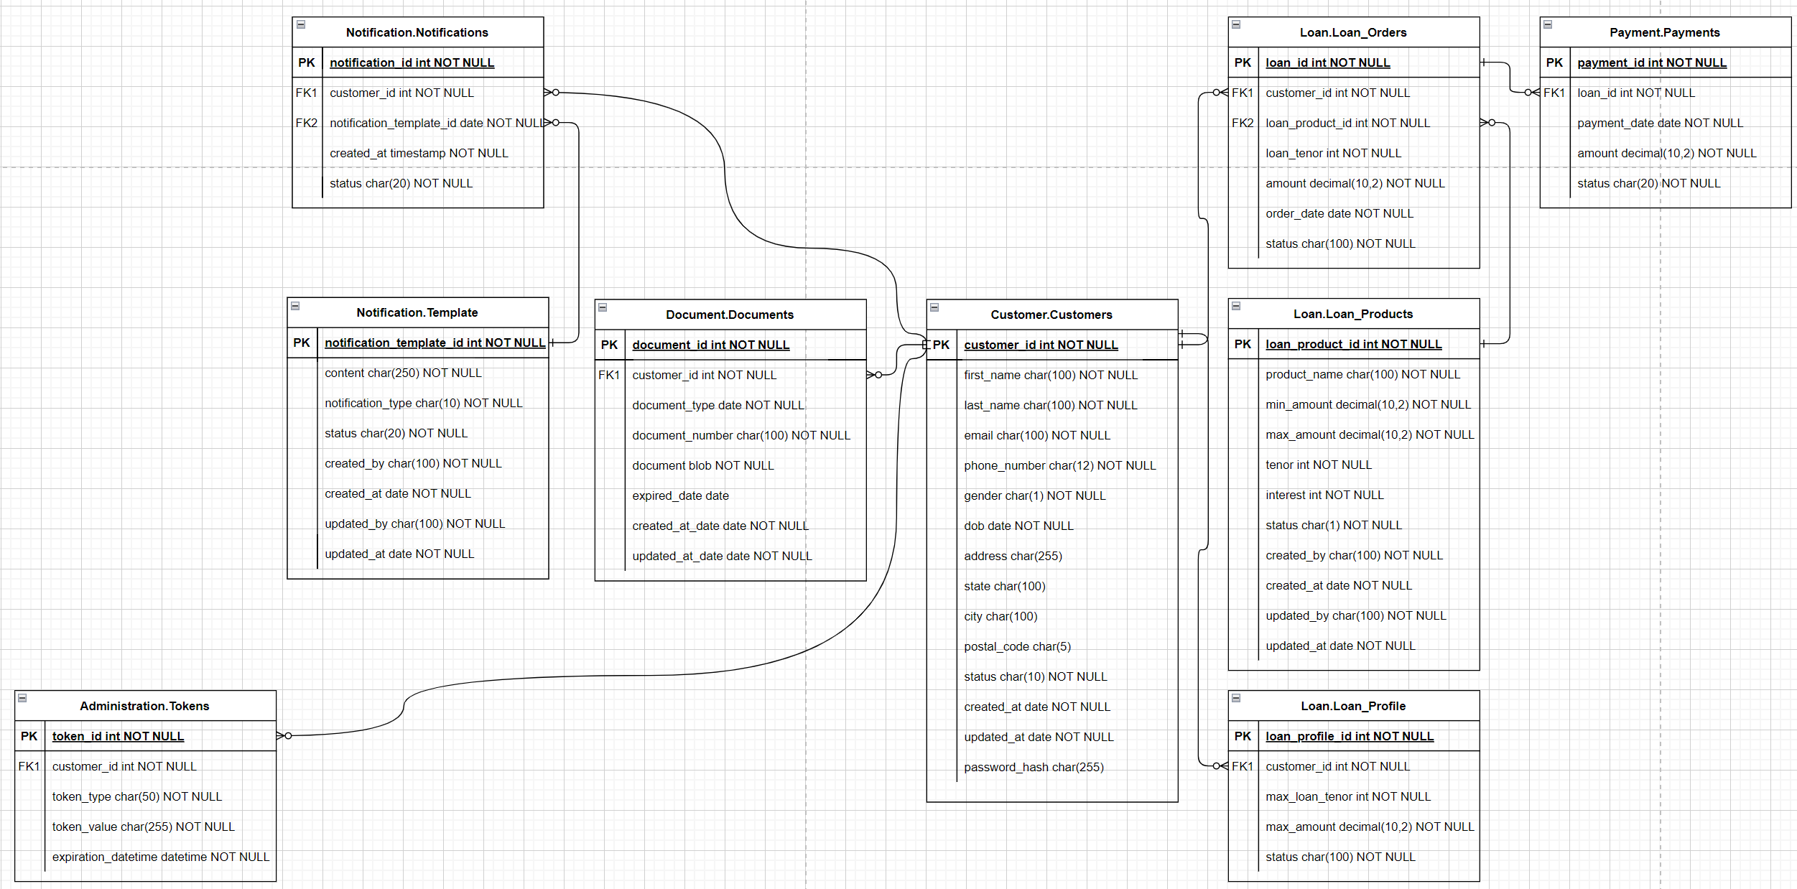
ERD (Entity Relationship Diagram) – XYZ Loan Apps

Slide 5
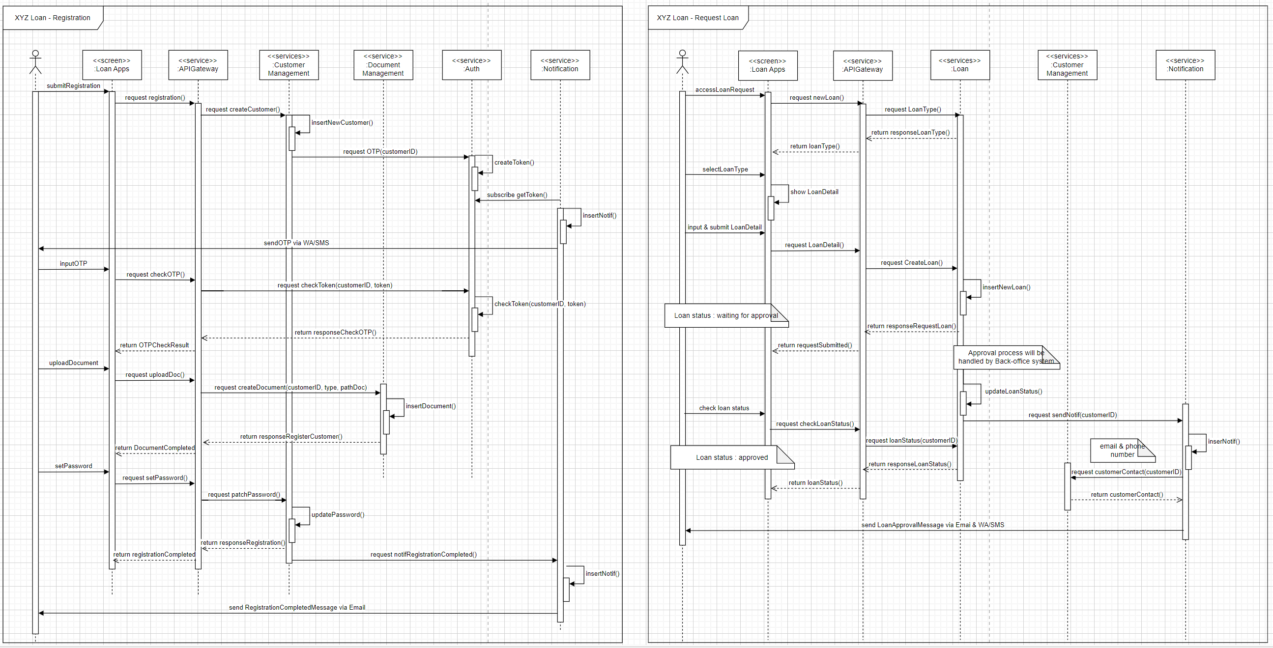
Sequence Diagram – XYZ Loan Apps : Registration & Request Loan

Slide 6
API CustomerManagement Services
Endpoint URL : https://xyzloan.com/customermanagement-service/v1/
Consumer : API Gateway Services, Notification Services
Description : API Customer Management
No | Entity | Service Name | Operation | Path | Yaml
1 | Customer Management | Create Customer | POST | /customer
2 |  | Retrieve Customer | GET | /customer/{Id}
3 |  | Search Customer | GET | /customer
4 |  | Update Customer | PATCH | /customer/Id

Slide 7
API Loan Services
Endpoint URL : https://xyzloan.com/loan-service/v1/
Consumer : API Gateway Services
Description : API Loan & Product Loan
No | Entity | Service Name | Operation | Path | Yaml
1 | Loan | Create Loan | POST | /loan
2 |  | Retrieve Loan | GET | /loan/{Id}
3 |  | Search Loan | GET | /loan
4 |  | Update Loan | PATCH | /loan/{Id}
5 | Loan Product | Create Loan Product | POST | /loanProduct
6 |  | Retrieve Loan Product | GET | /loanProduct/{Id}
7 |  | Search Loan Product | GET | /loanProduct/
8 |  | Update Loan Product | PATCH | /loanProduct/{Id}

Slide 8
API Notification Services
Endpoint URL : https://xyzloan.com/notification-service/v1/
Consumer : CustomerManagement Services, Loan Services
Description : API Notification & Template Notification
No | Entity | Service Name | Operation | Path | Yaml
1 | Notification | Create Notification | POST | /notification
2 |  | Retrieve Notification | GET | /notification/{Id}
3 |  | Search Notification | GET | /notification
4 |  | Search Notification Template | GET | /notificationTemplate/
5 |  | Update Notification Template | PATCH | /notificationTemplate/{Id}

Slide 9
API Payment Services
Endpoint URL : https://xyzloan.com/payment-service/v1/
Consumer : API Gateway Services
Description : API Payment
No | Entity | Service Name | Operation | Path | Yaml
1 | Payment | Create Payment | POST | /payment
2 |  | Retrieve Payment | GET | /payment/{Id}
3 |  | Search Payment | GET | /payment

Slide 10
API Auth Services
Endpoint URL : https://xyzloan.com/auth-service/v1/
Consumer : CustomerManagement Services
Description : API Authentication & Authorization
No | Entity | Service Name | Operation | Path | Yaml
1 | Authentication & Authorization | Create Auth | POST | /auth
2 |  | Retrieve Auth | GET | /auth/{Id}
3 |  | Search Auth | GET | /auth

Slide 11
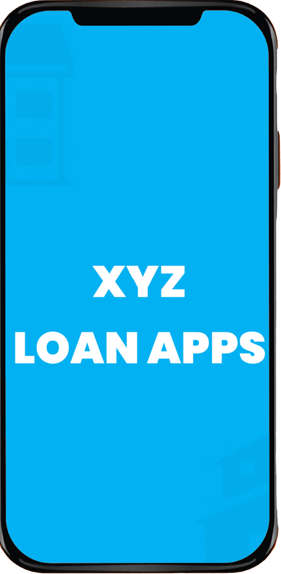
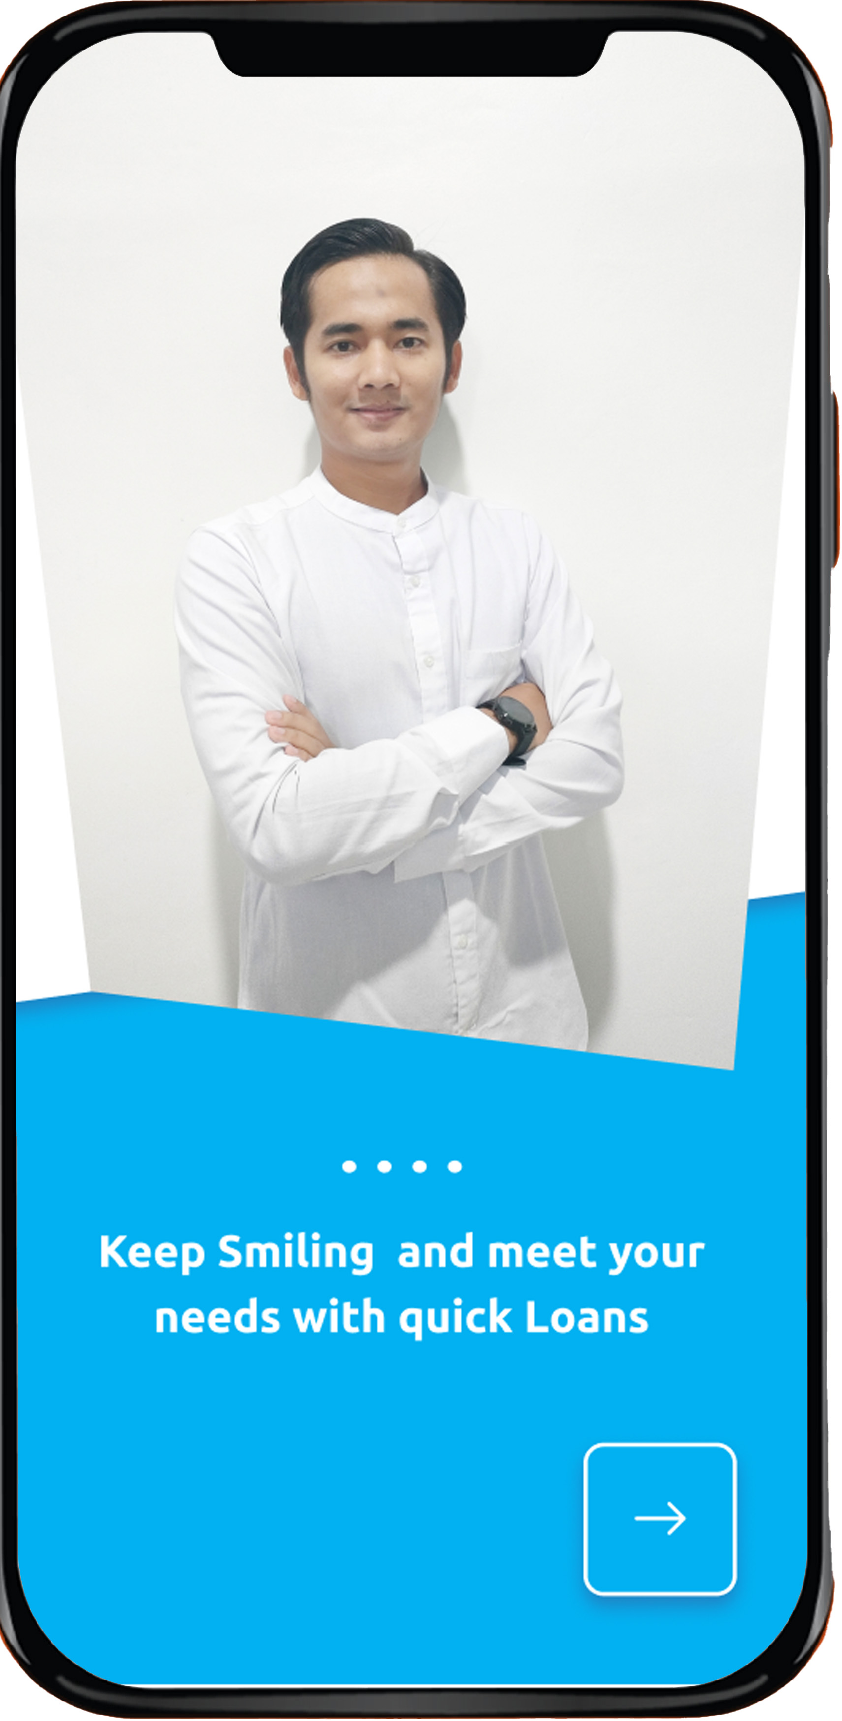
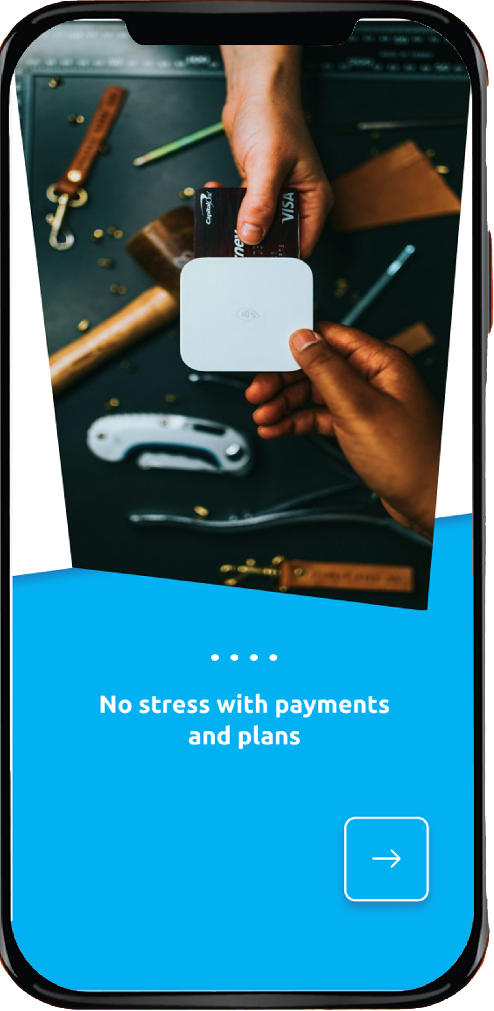
1. Mockup Splash Screen - Loan Apps

Slide 12
2. Mockup Login Screen - Loan Apps
Existing Customer
Customer Open & Access XYZ Loan Apps
Input Account Number / Email & Password
Click Login Button
Or customer able to Login with Biometric
Login succeed and screen will direct to dashboard
New Customer / Register
User Open & Access XYZ Loan Apps
Click Activate Account
Screen will direct to registration form

Slide 13
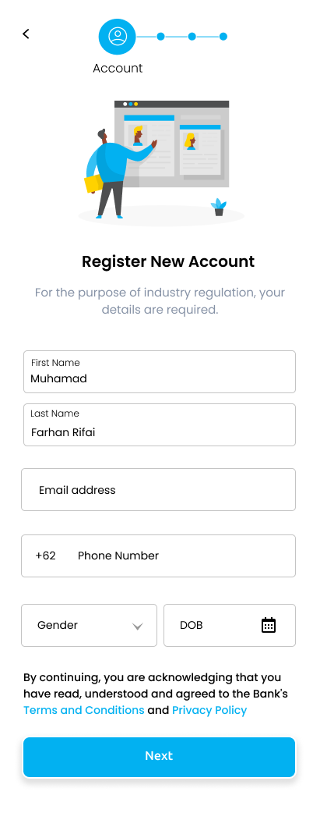
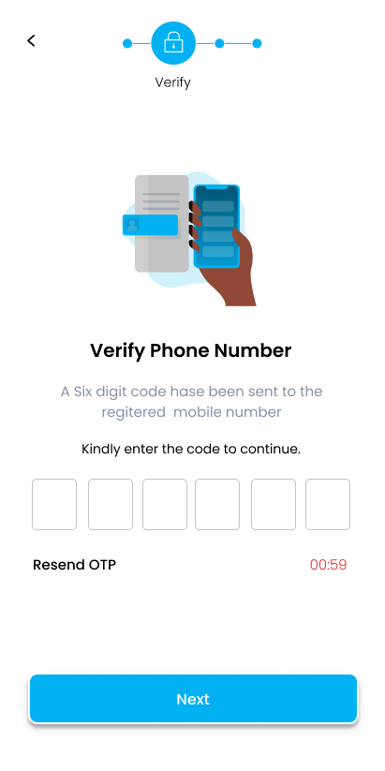
3. Mockup Registration Screen – Account
Register New Account
Verify Phone Number
[Mandatory] Input First Name
[Mandatory] Input Last Name
[Mandatory] Input Email Address
[Mandatory] Input Phone Number
[Mandatory] Select Gender
[Optional] Choose Date Of Birth
Click Next Button
Apps will sent OTP to customer
Customer will received OTP via SMS/WA
Input OTP
Click Next Button

Slide 14
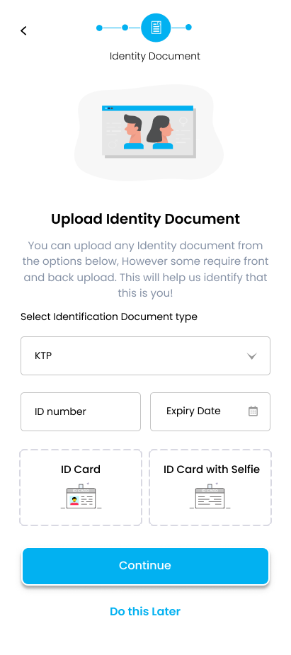
4. Mockup Registration Screen – Identity Document
Upload Identity Document
[Mandatory] Select Identification Document Type
[Mandatory] Input ID Number
[Optional] Input Expiry Date ID
[Mandatory] Upload ID Card
[Mandatory] Upload ID Card with selfie
Click Continue Button
Or you can Do this later

Slide 15
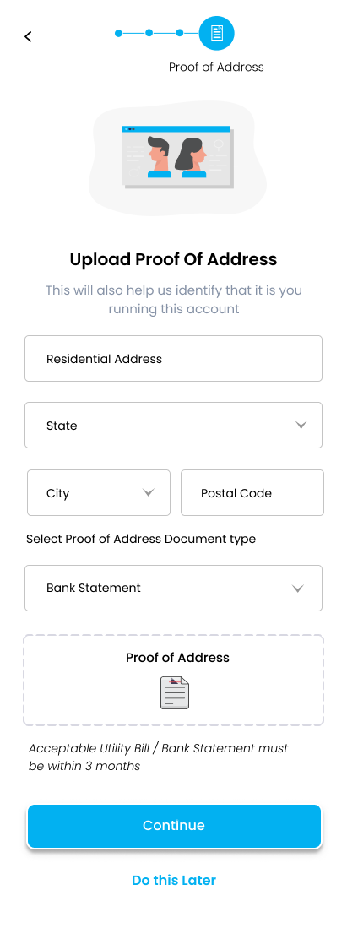
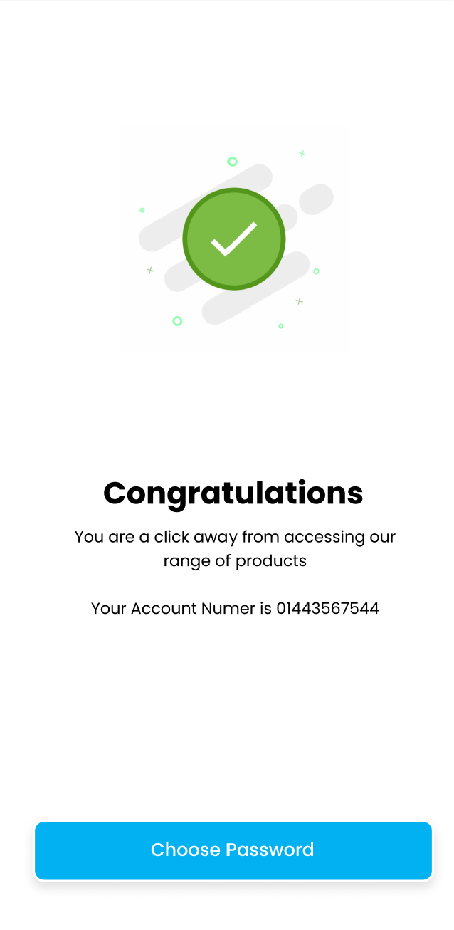
5. Mockup Registration Screen – Proof of Address
Upload Proof Of Address
[Mandatory] Input Residential Address
[Mandatory] Select State
[Mandatory] Select City
[Mandatory] Input Postal Code
[Mandatory] Select Proof of Address Document Type
[Mandatory] Upload Proof of Address document
Click Continue Button
Show popup registration success and show Account Number
Click Choose Password Button
Or you can Do this later
Account Number

Slide 16
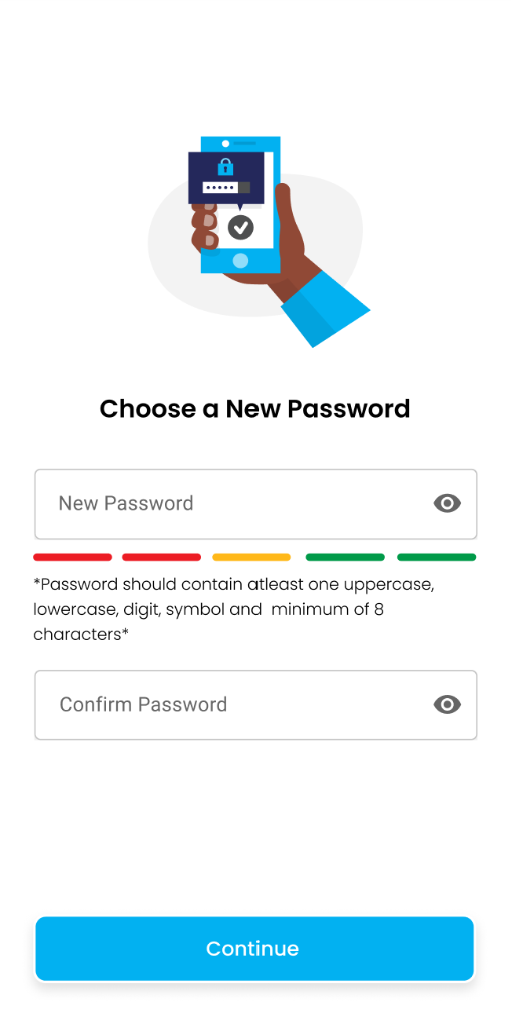
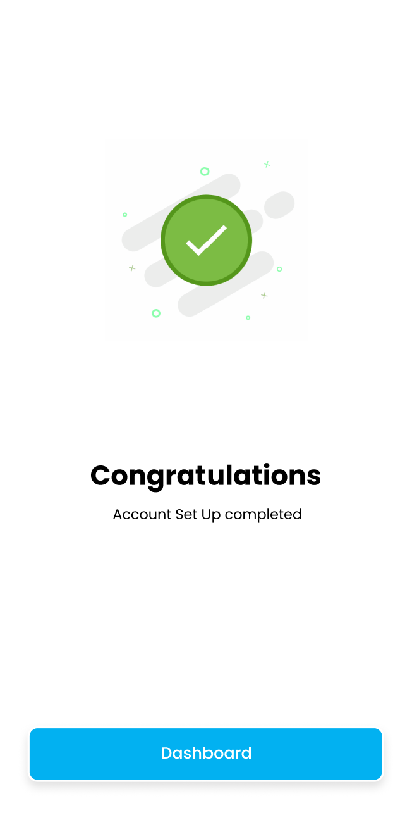
6. Mockup Registration Screen – Choose Password
Upload Proof Of Address
[Mandatory] Input New Password
[Mandatory] Confirm Password
Click Continue Button
Show popup set password completed
Click Dashboard Button
Or you can Do this later

Slide 17
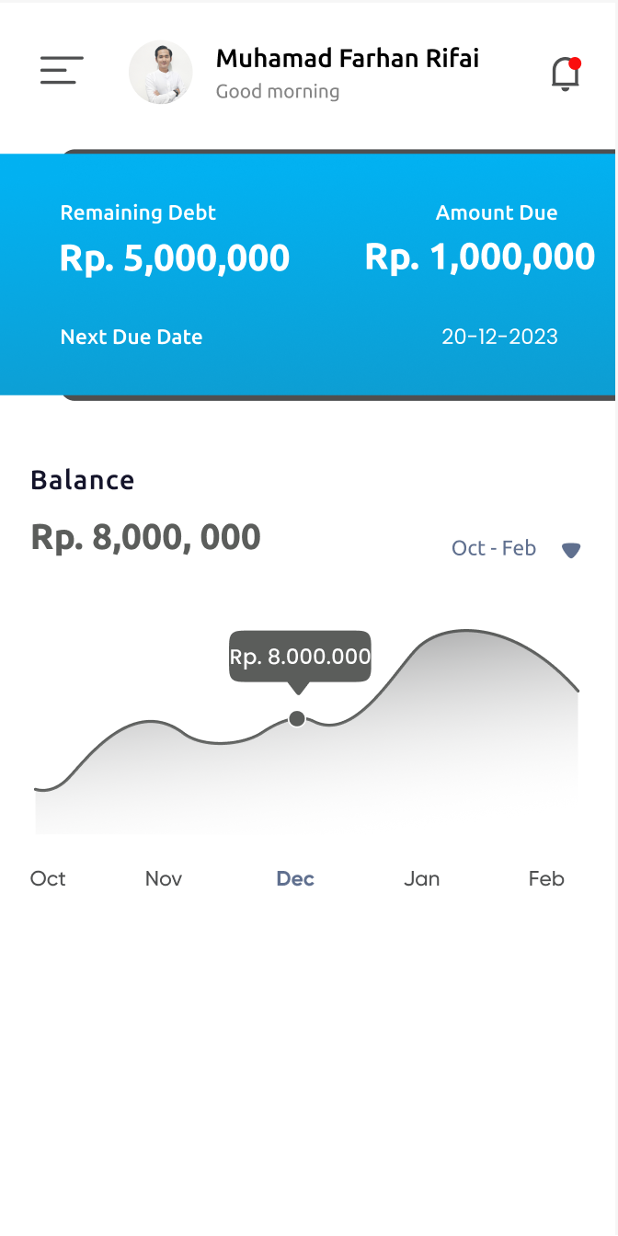
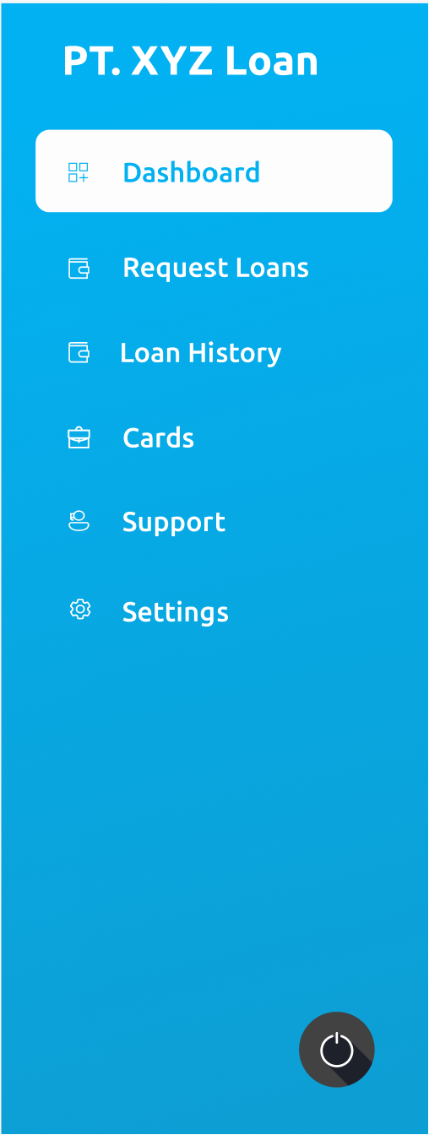
7. Mockup Dashboard Screen – Dashboard & Sidebar
Dashboard Information:
Sidebar Menu:
Customer Profile → User able go to personal information page
Remaining Debt
Amount Due
Next Due Date
Balance & Graphic
Notification
Sidebar
Dashboard
Request Loan
Loan History
Card
Support → User able to chat with chatbot or show helpdesk team contact call or email or WhatsApp
Setting

Slide 18
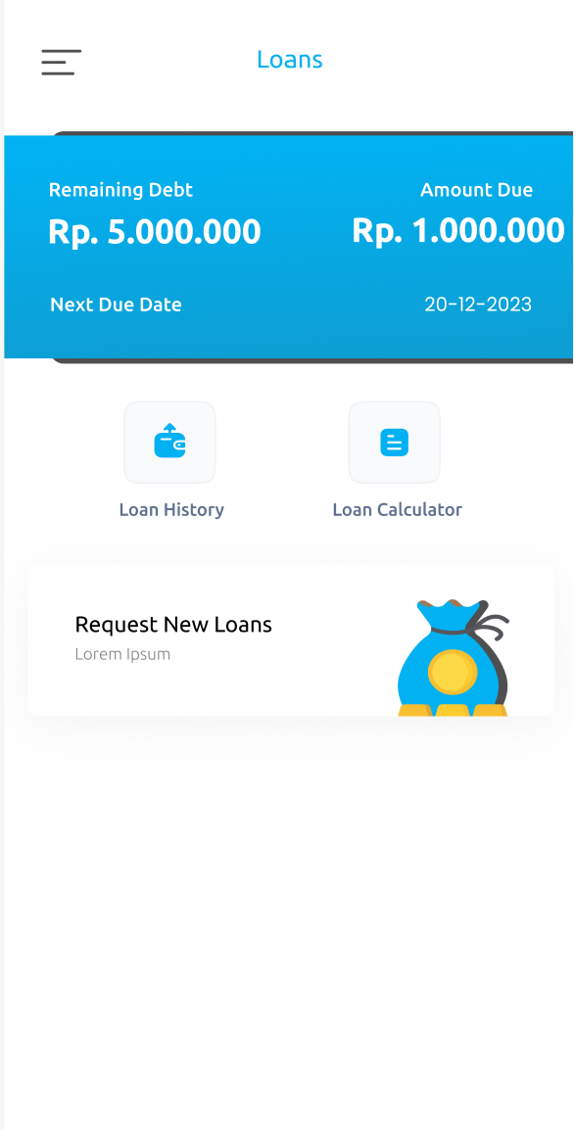
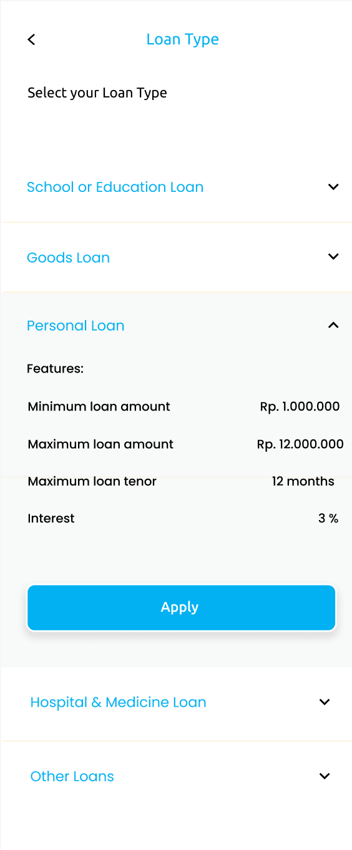
8. Mockup Loan Screen – Request Loan
Loan Page Information:
Select Loan Type :
Remaining Debt
Amount Due
Next Due Date
Loan History
Loan Calculator
Click Request New Loans
Select Loan Type Customers will choose the type of loan according to their needs
System will show detail of Loan Type Features
Click Apply Button

Slide 19
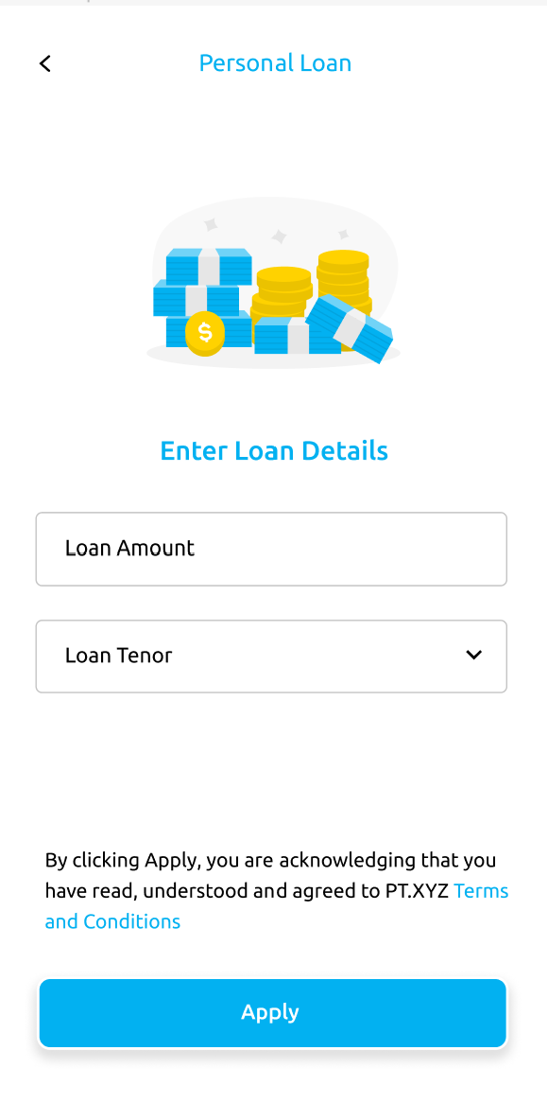
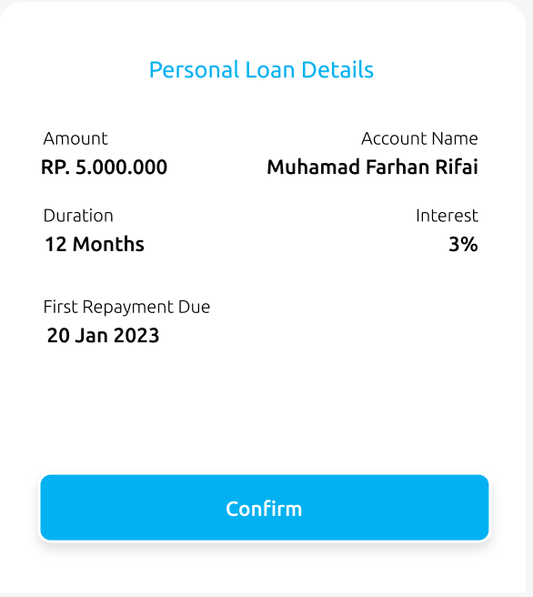
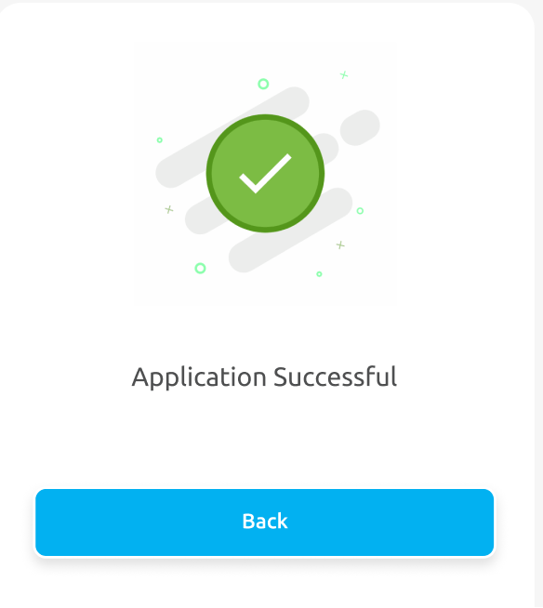
9. Mockup Loan Screen – Request Loan Details
Enter Loan Details :
[Mandatory] Input Loan Amount
[Mandatory] Select Loan Tenor
Click Term and Condition to know the detail Loan contract
Click Apply Button
Loan will success to request
Show confirmation popup loan detail
Will show Loan Information detail & Click Confirm Button
Show success popup
Click Back Button

Slide 20
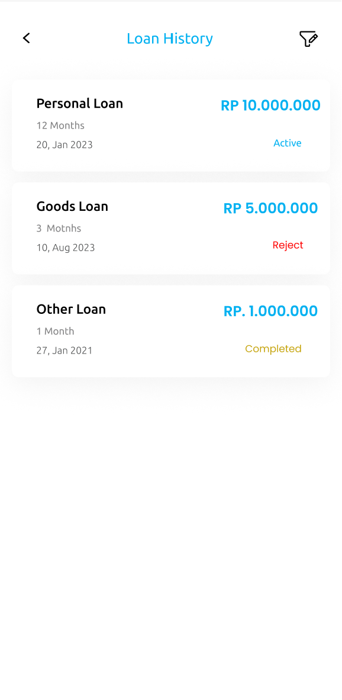
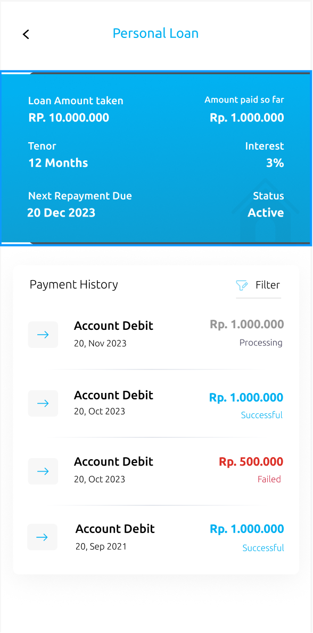
10. Mockup Loan Screen – Loan & Payment History
Check status Loan :
Loan Detail :
Show information progress status Loan Request Status will be : → Waiting for Approval : Loan still on verify by Back-office team → Approved : Loan already approved and ready to disburse → Active : Loan already disbursed to customer → Completed : Loan already paid off → Rejected : Loan rejected by Back-office team
Show information Loan Type, Tenor, Loan request date, Amount of Loan and Loan Status
Click Loan Type List
Show Loan Type Detail
Show information Loan Type Detail
Show information Payment History

Slide 21
Thank you !
Hopefully I can contribute to your great team
07 December 2023

